Slide 1



EMPLOYEE PAYROLL MANAGEMENT SYSTEM
Presenter By
Bakiyalakshmi.M

Slide 2


Module
Admin Attendance dashboard
User Attendance dashboard

Slide 3


Admin Attendance Module
The Admin can view the attendance of employee from start time of login and end time of their work.
Admin can edit and delete the attendance of an user if any changes in their timings.
They can also add attendance of an employee by entering their Employee id, Name, Start time, End time, Date and Status.
Also admin can update any details regarding the attendance of an employee in this dashboard.

Slide 4
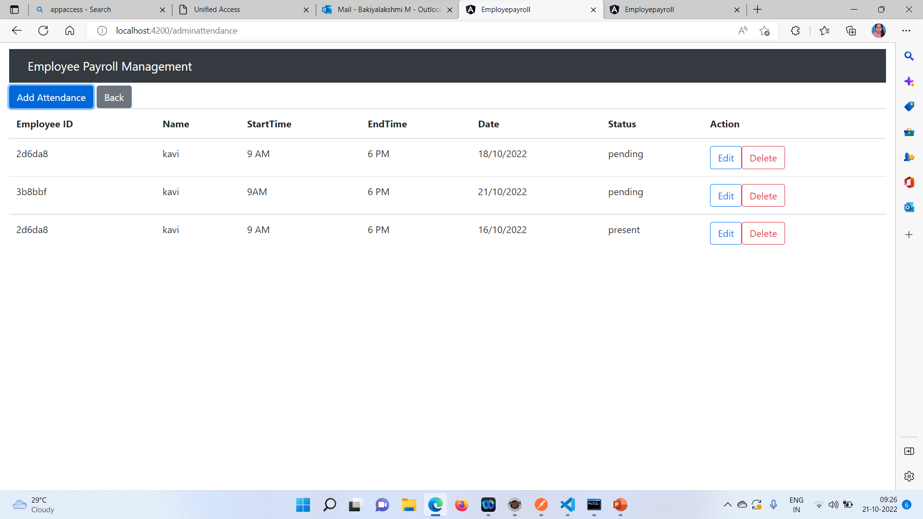
Module Screenshots

Slide 5

User Attendance Module
The User Attendance Dashboard provides the attendance details for an user.
The User can use this dashboard for starting their day of work by entering some data like their id, start time, end time and so on.
The Attendance Dashboard helps the admin to track their daily basis of work for salary purposes and number of leaves.

Slide 6
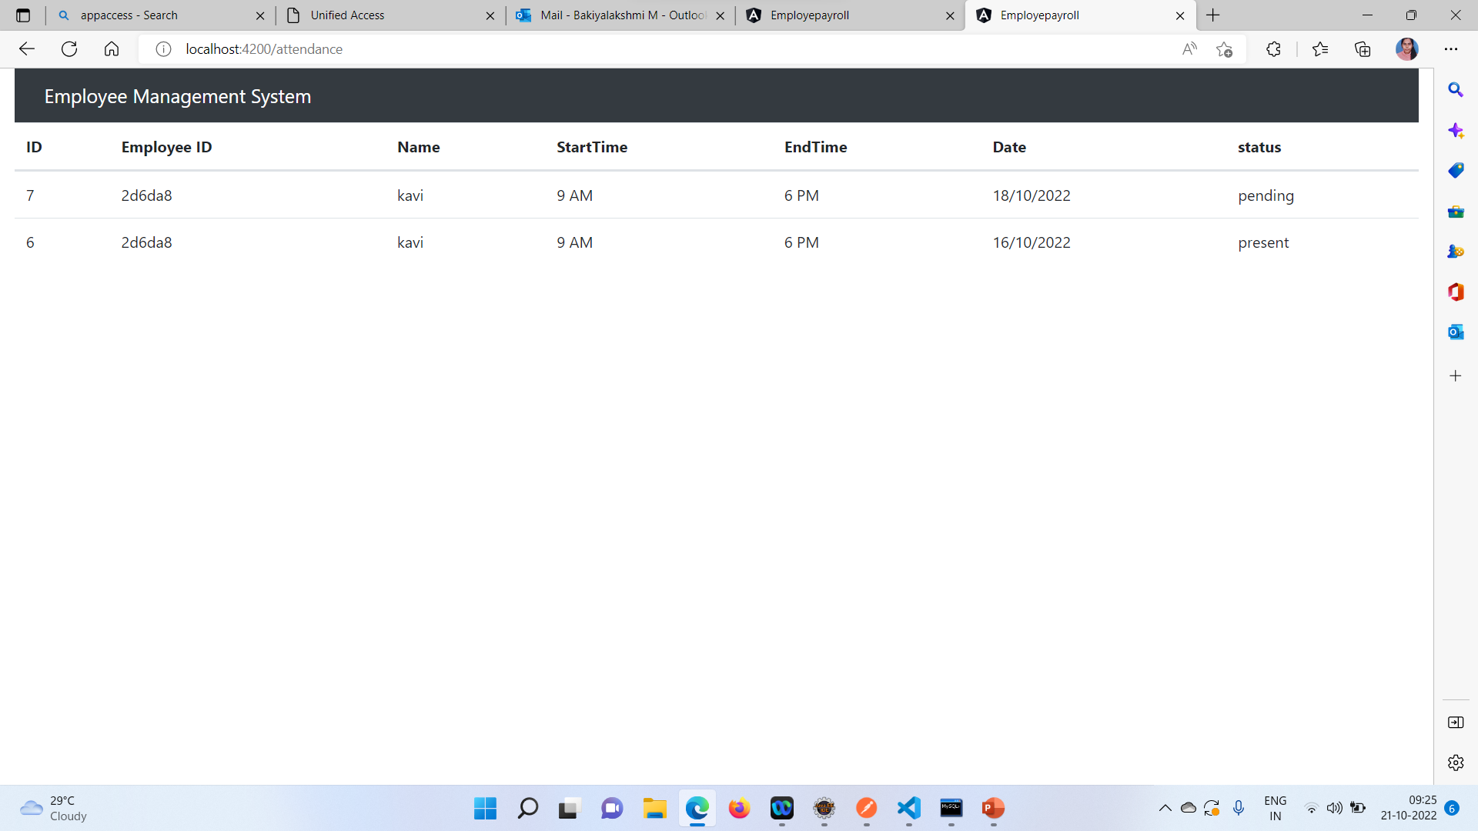
Module screenshot

Slide 7


Entity Repository Services Controller
Backend code
SPRINGBOOT

Slide 8

Post-It creates a new resource Put- It updates an existing resource Get- It reads a resource Delete-It deletes the resource

Slide 9
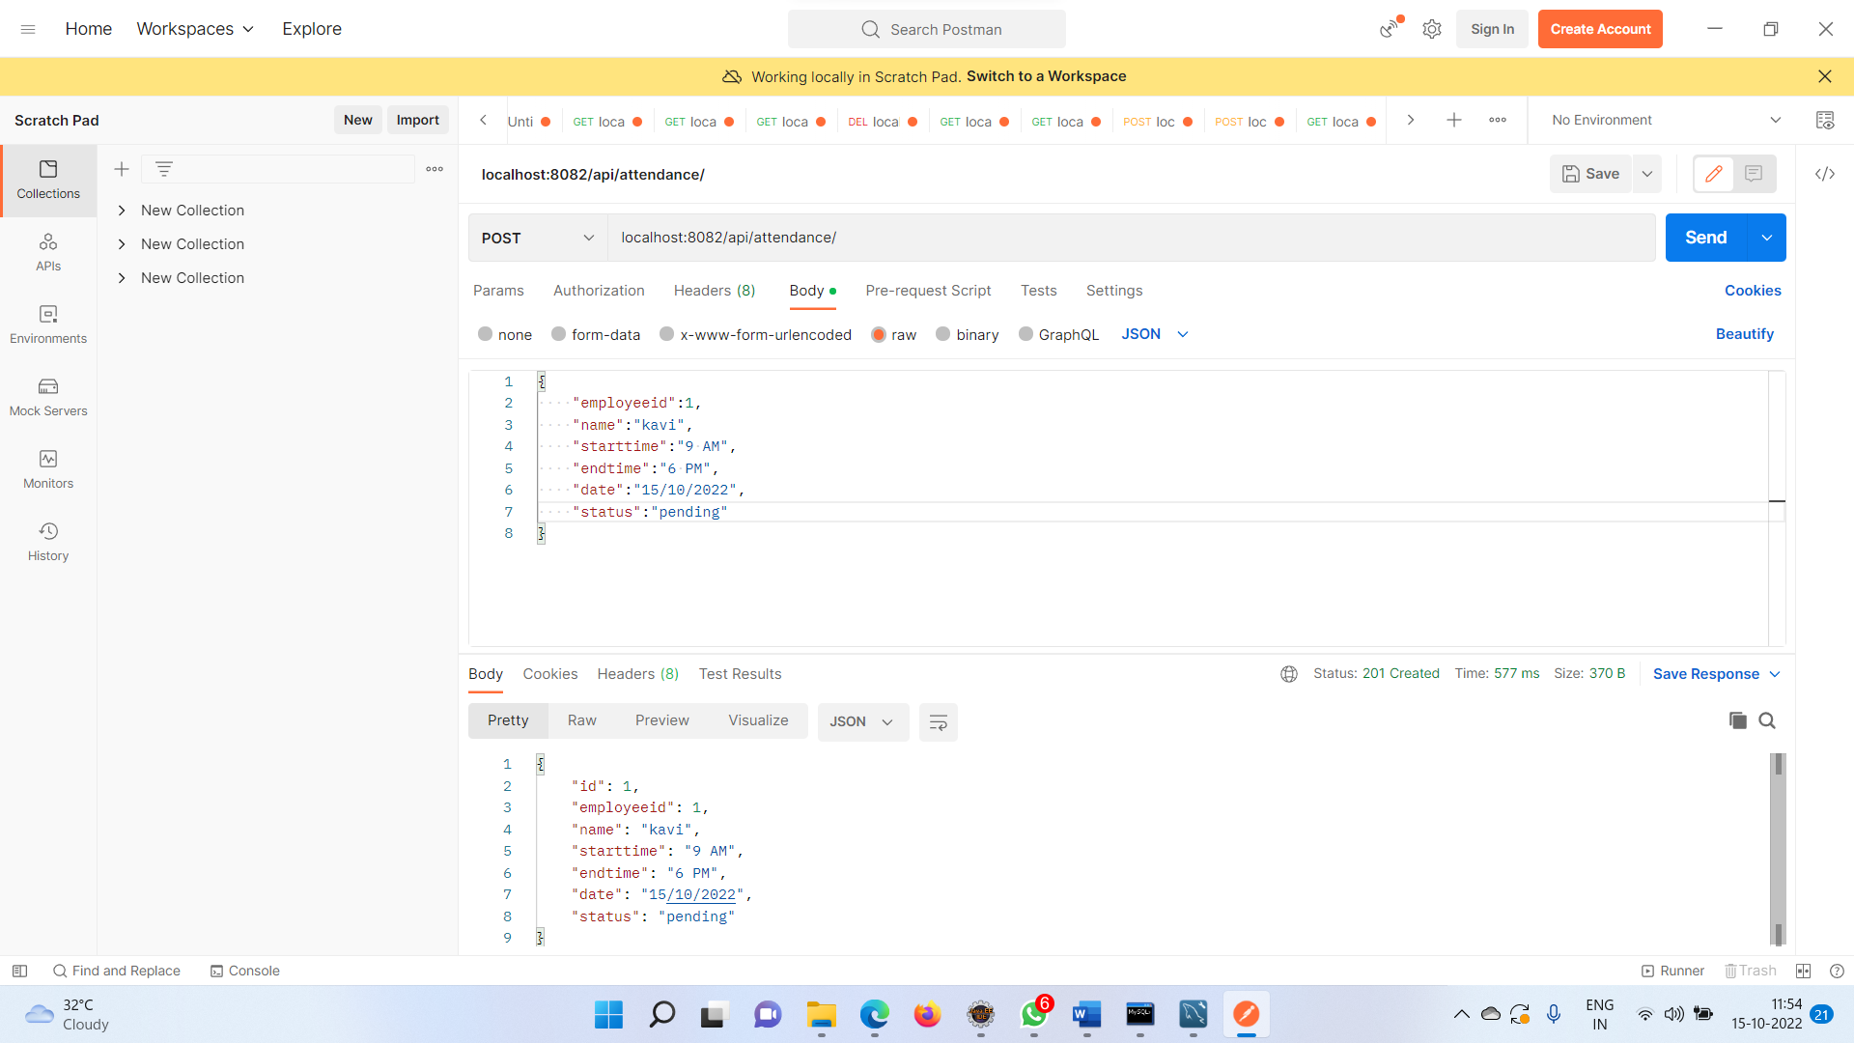
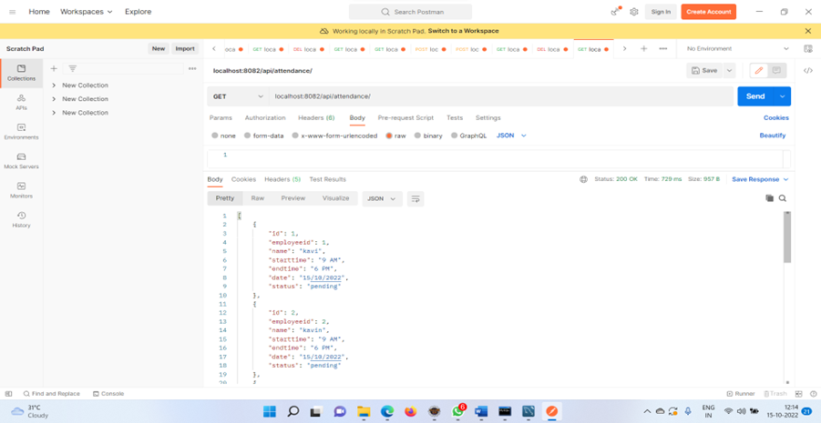
Backend Code Screenshot

Slide 10
Component Model service
Frontend Code
HTML TypeScript
ANGULAR
Entity classes
Data services

Slide 11

Conclusion
At Contoso, we believe in giving 110%. By using our next-generation data architecture, we help organizations virtually manage agile workflows. We thrive because of our market knowledge and great team behind our product. As our CEO says, “Efficiencies will come from proactively transforming how we do business.”

Slide 12




Thank you

